Slide 1
Predictive Model for Chronic Hepatitis B Virus Infection
Alec Langowski, Eman Hagos,
Hayden Kimball, Genevieve Johnson

Slide 2
NHANES Datasets
National Health and Nutrition Examination Survey data collected in 2015-2016 & 2017-2018:
Demographics data
Hepatitis B: Core Antibody, Surface Antigen, and Hepatitis D Antibody (lab)
Hepatitis B: Surface Antibody (lab)
Lab datasets were used to classify patients into 4 classes:
Vaccinated
Currently infected
Previously infected (with immunity)
No immunity (not vaccinated or previously infected)

Slide 3
Demographic Data
Demographic variables used: gender, race, age, and household income
What metrics are we interested in?
Infection rate: % of population currently infected
Vaccination rate: % of population vaccinated
Immunity rate: % of people vaccinated or previously infected
Infection rate of non vaccinated people
Safe groups will have low infection rates (both) and high vaccination/immunity rates.

Slide 4
Gender
Gender | Infection Rate | Vaccination Rate | Immunity Rate | I.R. Non Vaccinated
Male | 1.08% | 23.98% | 25.3% | 1.42%
Female | 0.56 | 26.84% | 27.57% | 0.77%

Slide 5
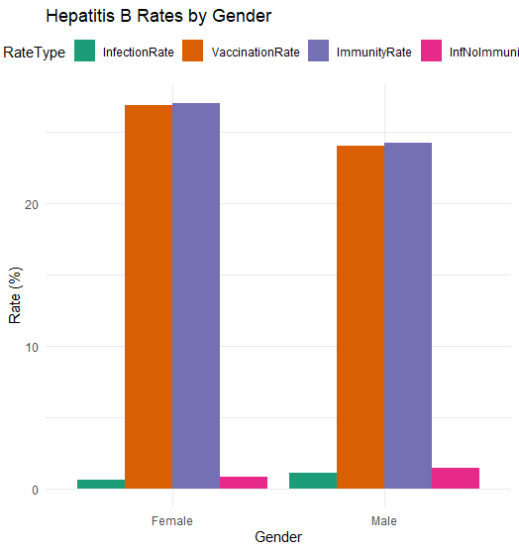
Gender

Slide 6
Race
Race | Infection Rate | Vaccination Rate | Immunity Rate | I.R. Non Vaccinated
Mexican American | 0.27% | 22.62% | 22.91% | 0.35%
Hispanic | 0.84% | 28.78% | 29.73% | 1.18%
White | 0.47% | 23.91% | 24.4% | 0.61%
Black | 2.04% | 27.85% | 30.26% | 2.82%
Asian | 3.31% | 39.46% | 45.03% | 5.47%
Other | 0.35% | 24.03% | 24.64% | 0.46%

Slide 7
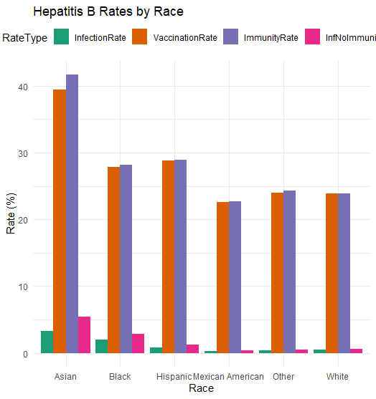
Race

Slide 8
Age
Age | Infection Rate | Vaccination Rate | Immunity Rate | I.R. Non Vaccinated
0-9 | 0.1% | 28.65% | 28.75% | 0.14%
10-19 | 0.19% | 28.1% | 28.38% | 0.27%
20-29 | 0.29% | 51.58% | 52.08% | 0.6%
30-39 | 0.56% | 23.14% | 24.02% | 0.72%
40-49 | 1.31% | 18.32% | 19.91% | 1.61%
50-59 | 1.79% | 17.64% | 19.76% | 2.17%
60-69 | 1.56% | 15.46% | 17.2% | 1.84%
70+ | 0.99% | 10.63% | 11.79% | 1.11%

Slide 9
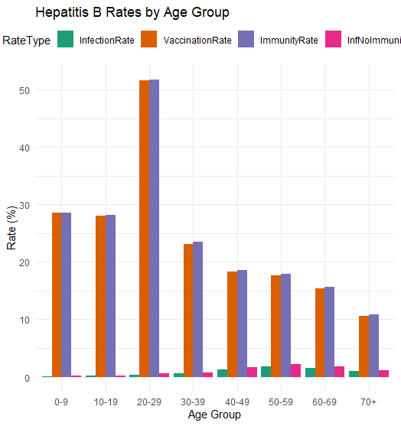
Age

Slide 10
Household Income
Status Income | Infection Rate | Vaccination Rate | Immunity Rate | I.R. Non Vaccinated
$0 – 24,999 | 2.27% | 25.72% | 28.18% | 3.05%
$25,000 – 44,999 | 0.7% | 24.1% | 25.14% | 0.93%
$45,000 – 74,999 | 0.77% | 25.11% | 25.97% | 1.02%
$75,000+ | 0.48% | 26.52% | 27.12% | 0.66%

Slide 11
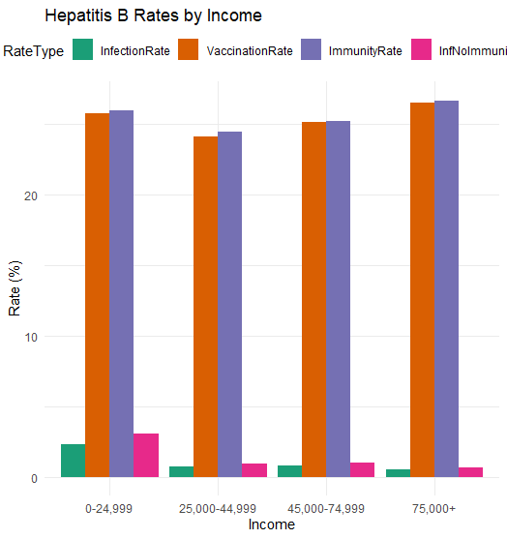
Household Income

Slide 12
Conclusions
Gender
Males have a higher infection rate across the board as well as a lower vaccination rate
Race
Black and Asian populations have by far the highest infection rates, but also surprisingly some of the highest vaccination rates
The Hispanic population has an average vaccination rate, but an extremely high immunity rate, which indicates mass infection in the past
The numbers for non-whites are worse on average

Slide 13
Conclusions (continued)
Age
Vaccination rates steady for young people, booming in the 20-29 age range and tapering off as age increases
Infection rates low until the 40+ ranges peaking in the 50-59 range
Income
Vaccination rates are stable, unexplained jump in the 25,000-44,999 range's immunity rate
0-24,999 range has by far the highest infection rate and 75,000 has by far the lowest as expected

